Slide 1

How AI is Transforming E-Commerce & Retail
Presenter: Koncpt AI

Slide 2

Content
1. The Impact of AI on Consumer Behavior
2. AI Technologies Revolutionizing Retail
3. Challenges and Considerations in AI Adoption
4. Embracing AI for Future Success

Slide 3


Section 1
The Impact of AI on Consumer Behavior

Slide 4


Understanding AI's Role in Shopping Preferences
01
02
03
Personalized Recommendations
Behavioral Insights
Dynamic Pricing Strategies
By tracking user interactions and preferences, AI helps retailers understand consumer behavior patterns, allowing for more effective marketing strategies and inventory management.
AI algorithms analyze consumer data to provide tailored product suggestions, enhancing the shopping experience and increasing conversion rates.
AI enables real-time pricing adjustments based on demand, competition, and consumer behavior, optimizing sales and maximizing profitability for retailers.

Slide 5


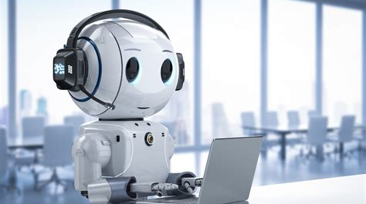

Personalization and Customer Experience Enhancement
Tailored Shopping Experiences
Enhanced Customer Engagement
Predictive Personalization
By leveraging machine learning, retailers can anticipate customer needs and preferences, enabling proactive marketing strategies that enhance the overall shopping journey and drive repeat purchases.
AI-driven personalization allows retailers to create unique shopping experiences for each customer, utilizing data to recommend products that align with individual preferences and past behaviors.
Through AI chatbots and virtual assistants, businesses can provide immediate support and personalized interactions, significantly improving customer satisfaction and loyalty.

Slide 6

Predictive Analytics in Consumer Trends
Understanding Consumer Behavior
Predictive analytics utilizes historical data and machine learning algorithms to forecast future consumer behaviors, enabling retailers to tailor their marketing strategies and product offerings effectively.
Optimizing Inventory Management
By predicting trends in consumer demand, businesses can optimize their inventory levels, reducing excess stock and minimizing stockouts, ultimately leading to improved operational efficiency and customer satisfaction.
Enhancing Targeted Marketing
Retailers can leverage predictive analytics to segment their customer base more accurately, allowing for targeted marketing campaigns that resonate with specific consumer groups, thereby increasing engagement and conversion rates.

Slide 7
Case Studies: Successful AI Implementations
01
02
03
Amazon's Recommendation Engine
Walmart's Inventory Management
Sephora's Virtual Artist
Sephora's AI-powered Virtual Artist allows customers to try on makeup virtually, increasing engagement and conversion rates by providing a personalized shopping experience that caters to individual beauty preferences.
Amazon utilizes advanced AI algorithms to analyze customer behavior and preferences, resulting in a recommendation engine that drives 35% of its total sales by suggesting products tailored to individual shoppers.
Walmart employs AI-driven predictive analytics to optimize inventory levels across its vast network of stores, reducing stockouts by 10% and improving overall supply chain efficiency, which enhances customer satisfaction.

Slide 8

Section 2
AI Technologies Revolutionizing Retail

Slide 9



Machine Learning and Data Analysis
Enhanced Customer Insights
Automated Decision-Making
Fraud Detection and Prevention
Machine learning algorithms analyze vast amounts of consumer data to uncover patterns and preferences, enabling retailers to tailor their offerings and marketing strategies effectively.
Data analysis powered by machine learning allows for real-time decision-making in inventory management and pricing strategies, optimizing operational efficiency and responsiveness to market changes.
Machine learning models can identify unusual transaction patterns, helping e-commerce businesses detect and prevent fraudulent activities, thereby protecting both the retailer and the consumer.

Slide 10
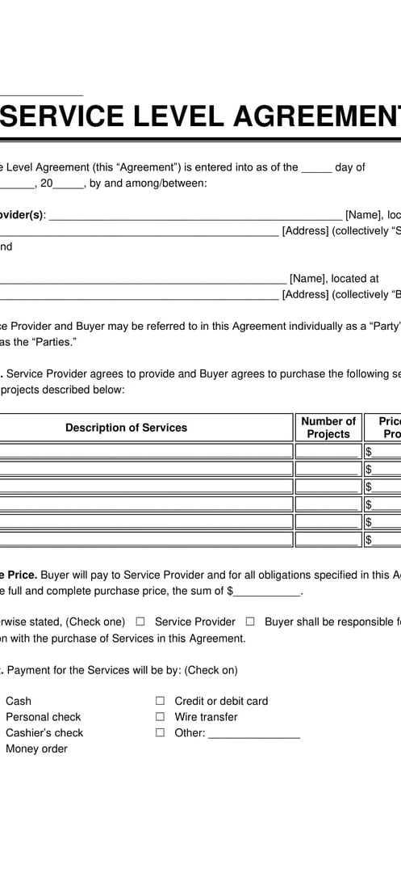
Chatbots and Virtual Assistants in Customer Service
24/7 Customer Support
Chatbots provide round-the-clock assistance, ensuring that customer inquiries are addressed promptly, which enhances customer satisfaction and reduces wait times for responses.
Personalized Interactions
Virtual assistants utilize customer data to deliver tailored responses and recommendations, creating a more engaging shopping experience that fosters customer loyalty and repeat business.
Cost Efficiency
Implementing chatbots reduces operational costs by automating routine inquiries and support tasks, allowing human agents to focus on more complex issues, and ultimately improving service efficiency.

Slide 11
Augmented Reality and Virtual Try-Ons
01
02
03
Enhanced Shopping Experience
Increased Conversion Rates
Reduced Return Rates
Augmented reality (AR) allows customers to visualize products in their own environment or on themselves, significantly improving the online shopping experience and reducing the uncertainty associated with purchasing items like clothing and accessories.
Virtual try-ons powered by AR technology have been shown to boost conversion rates, as customers are more likely to complete a purchase when they can see how a product looks on them or in their space, leading to higher sales for retailers.
By enabling customers to virtually try on products before buying, AR helps minimize the likelihood of returns due to sizing or style mismatches, ultimately saving retailers time and costs associated with processing returns.

Slide 12
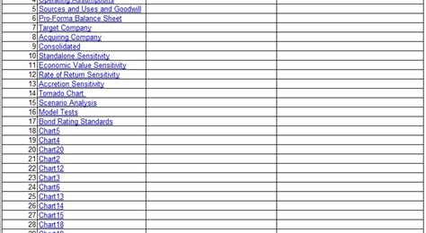
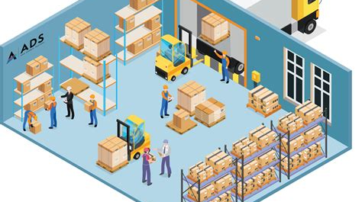
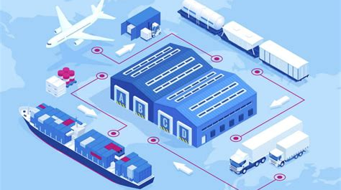
Inventory Management and Supply Chain Optimization
AI-Driven Demand Forecasting
Real-Time Inventory Tracking
Supply Chain Optimization
AI enhances supply chain management by analyzing data across the entire supply chain, identifying bottlenecks, and suggesting improvements, leading to reduced lead times and increased overall efficiency in product delivery.
AI algorithms analyze historical sales data and market trends to predict future demand, enabling retailers to optimize inventory levels and reduce excess stock, ultimately improving cash flow and operational efficiency.
Utilizing IoT and AI technologies, retailers can monitor inventory levels in real-time, allowing for immediate adjustments and replenishments, which minimizes stockouts and enhances customer satisfaction.

Slide 13
Section 3
Challenges and Considerations in AI Adoption

Slide 14

Data Privacy and Security Concerns
Consumer Data Protection
As AI systems collect and analyze vast amounts of consumer data, ensuring robust data protection measures is crucial to maintain customer trust and comply with regulations like GDPR and CCPA.
Risk of Data Breaches
The integration of AI in e-commerce increases the potential attack surface for cybercriminals, making it essential for businesses to implement advanced security protocols to safeguard sensitive customer information.
Transparency and Ethical Use
Retailers must prioritize transparency in how they use AI to process consumer data, fostering ethical practices that not only comply with legal standards but also enhance brand reputation and customer loyalty.

Slide 15
Integration with Existing Systems
01
02
03
Seamless Data Flow
Legacy System Compatibility
Employee Training and Support
Integrating AI technologies with existing retail systems ensures a seamless flow of data across platforms, enhancing operational efficiency and enabling real-time insights for better decision-making.
Best practices involve assessing the compatibility of AI solutions with legacy systems, allowing for gradual integration that minimizes disruption while maximizing the benefits of AI capabilities.
Successful integration requires comprehensive training programs for employees, ensuring they are equipped to leverage AI tools effectively, which fosters a culture of innovation and enhances overall productivity.

Slide 16



Ethical Implications of AI in Retail
Consumer Privacy Concerns
Bias and Fairness Issues
Transparency in AI Decisions
AI algorithms can inadvertently perpetuate biases present in training data, leading to unfair treatment of certain consumer groups; retailers must actively work to identify and mitigate these biases to ensure equitable practices.
The use of AI in retail raises significant concerns regarding consumer privacy, as extensive data collection can lead to unauthorized use of personal information, necessitating robust data protection measures to maintain trust.
As AI systems increasingly influence business decisions, retailers must prioritize transparency in their algorithms and processes, allowing consumers to understand how their data is used and fostering accountability in AI applications.

Slide 17

Overcoming Resistance to Change
Understanding Employee Concerns
Addressing fears and uncertainties among employees regarding AI adoption is crucial; providing clear communication about the benefits and support available can help alleviate resistance and foster a positive attitude towards change.
Training and Development Programs
Implementing comprehensive training initiatives equips employees with the necessary skills to work alongside AI technologies, empowering them to embrace new tools and processes, which ultimately enhances productivity and job satisfaction.
Showcasing Success Stories
Highlighting case studies and examples of successful AI integration within the retail sector can inspire confidence and demonstrate the tangible benefits of change, encouraging stakeholders to support and engage in the transition process.

Slide 18
Section 4
Embracing AI for Future Success

Slide 19
Steps to Implement AI in Your Business
01
02
03
Assess Business Needs
Choose the Right Technology
Train Your Team
Invest in training programs for your employees to equip them with the necessary skills to work with AI technologies, fostering a culture of innovation and ensuring successful adoption across the organization.
Begin by identifying specific areas within your business that can benefit from AI, such as customer service, inventory management, or personalized marketing, to ensure targeted and effective implementation.
Research and select AI tools and platforms that align with your business goals, considering factors like scalability, ease of integration, and the ability to analyze data relevant to your operations.

Slide 20


Resources for Learning and Development
Online Courses and Certifications
Industry Reports and Whitepapers
Webinars and Workshops
Participate in live webinars and workshops hosted by industry experts and thought leaders, which cover practical applications of AI in retail, allowing for interactive learning and networking opportunities with peers.
Explore platforms like Coursera, edX, and Udacity that offer specialized courses in AI applications for e-commerce and retail, providing valuable knowledge and skills to enhance your business strategies.
Access comprehensive reports from organizations such as McKinsey, Gartner, and Forrester that analyze AI trends in retail, offering insights into best practices and future developments to inform your decision-making.

Slide 21

Join the AI Revolution in Retail Today
Unlock Competitive Advantage
Embracing AI technologies can significantly enhance operational efficiency, allowing retailers to streamline processes, reduce costs, and ultimately offer better prices and services to customers.
Enhance Customer Engagement
By leveraging AI for personalized marketing and customer service, businesses can create more meaningful interactions, fostering loyalty and increasing customer retention rates in a competitive market.
Future-Proof Your Business
Adopting AI not only addresses current market demands but also prepares your business for future trends, ensuring you remain relevant and capable of adapting to the rapidly evolving retail landscape.

Slide 22
Join Us!
Interested in learning more about how AI can enhance your E-Commerce & Retail experience?
Contact us today to discover our innovative solutions tailored to meet your needs.
Contact: Koncpt.ai@gmail.com

