Slide 1

How AI is Transforming Logistics & Supply Chain
Presenter: Koncpt AI

Slide 2


Content
1. The Impact of AI on Logistics
2. Enhancing Supply Chain Efficiency
3. Challenges and Considerations
4. Embrace AI for Logistics & Supply Chain

Slide 3

Section 1
The Impact of AI on Logistics

Slide 4

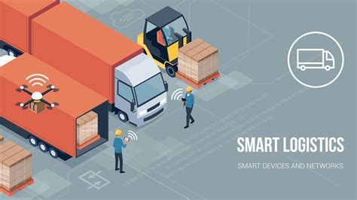
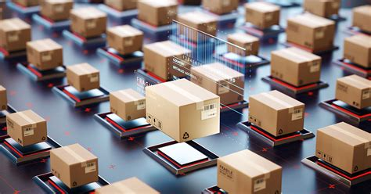

Introduction to AI in Logistics
Defining AI in Logistics
Transformative Industry Impact
Future Trends and Innovations
Artificial Intelligence (AI) refers to the simulation of human intelligence in machines, enabling them to perform tasks such as data analysis, decision-making, and predictive modeling, which are crucial for optimizing logistics operations.
AI is revolutionizing logistics by enhancing efficiency, reducing costs, and improving customer satisfaction through automation, real-time data processing, and advanced analytics, leading to smarter supply chain management.
As AI technology continues to evolve, its integration into logistics will drive innovations such as autonomous vehicles, drone deliveries, and AI-driven predictive maintenance, positioning companies to stay competitive in a rapidly changing market.

Slide 5

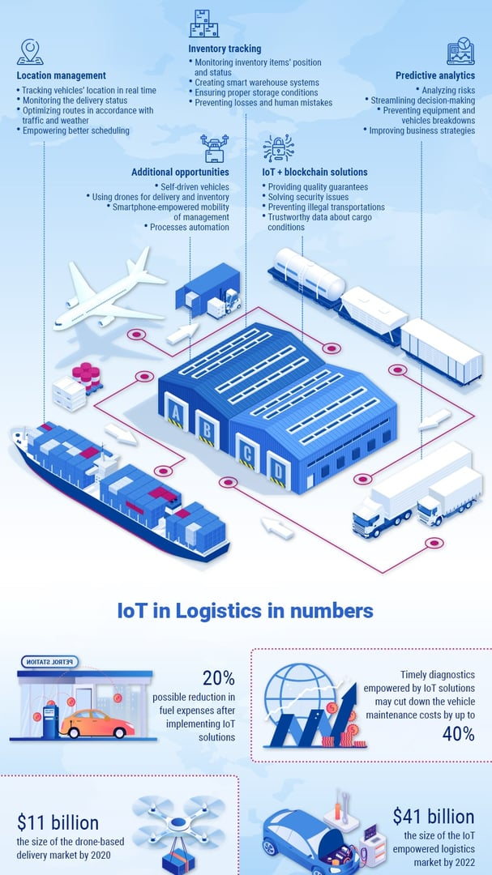
Key Technologies Driving Change
Machine Learning Algorithms
These algorithms analyze vast amounts of data to identify patterns and trends, enabling logistics companies to optimize routes, predict demand, and enhance inventory management, ultimately leading to cost savings and improved service levels.
Robotic Process Automation (RPA)
RPA streamlines repetitive tasks such as order processing and data entry, allowing human workers to focus on more strategic activities, thereby increasing operational efficiency and reducing the likelihood of errors in logistics operations.
Internet of Things (IoT)
IoT devices provide real-time tracking and monitoring of shipments, assets, and inventory, facilitating better visibility across the supply chain, enhancing decision-making, and improving responsiveness to market changes and customer needs.

Slide 6

Case Studies of AI Implementation
01
02
03
Walmart's Inventory Management
DHL's Predictive Analytics
Amazon's Robotics Integration
Walmart utilizes AI algorithms to analyze sales data and optimize inventory levels across its supply chain, resulting in reduced stockouts and improved product availability, ultimately enhancing customer satisfaction and operational efficiency.
DHL employs AI-driven predictive analytics to forecast demand and optimize delivery routes, which has led to a significant reduction in transportation costs and improved delivery times, showcasing the effectiveness of AI in logistics operations.
Amazon has integrated AI-powered robotics in its fulfillment centers to automate picking and packing processes, increasing throughput and accuracy while reducing labor costs, demonstrating the transformative potential of AI in supply chain management.

Slide 7



Benefits of AI in Logistics Operations
Enhanced Operational Efficiency
Improved Decision-Making
Increased Customer Satisfaction
With advanced data analytics and predictive modeling, AI provides logistics managers with actionable insights, enabling them to make informed decisions that enhance supply chain performance and responsiveness.
AI streamlines logistics processes by automating routine tasks, optimizing routes, and improving inventory management, leading to significant time and cost savings for businesses.
By leveraging AI for real-time tracking and personalized service, companies can meet customer expectations more effectively, resulting in higher satisfaction rates and stronger customer loyalty.

Slide 8

Section 2
Enhancing Supply Chain Efficiency

Slide 9
AI-Powered Demand Forecasting
01
02
03
Predictive Analytics for Accuracy
Dynamic Adjustments in Real-Time
Cost Reduction and Efficiency Gains
AI utilizes advanced predictive analytics to analyze historical sales data, market trends, and external factors, enabling logistics companies to forecast demand with greater accuracy and reduce the risk of overstocking or stockouts.
By leveraging machine learning algorithms, AI can continuously learn from new data inputs, allowing for dynamic adjustments to demand forecasts in real-time, which enhances responsiveness to changing market conditions and customer preferences.
Implementing AI-powered demand forecasting leads to significant cost reductions in inventory management and logistics operations, as companies can optimize their supply chain processes, minimize waste, and improve overall operational efficiency.

Slide 10
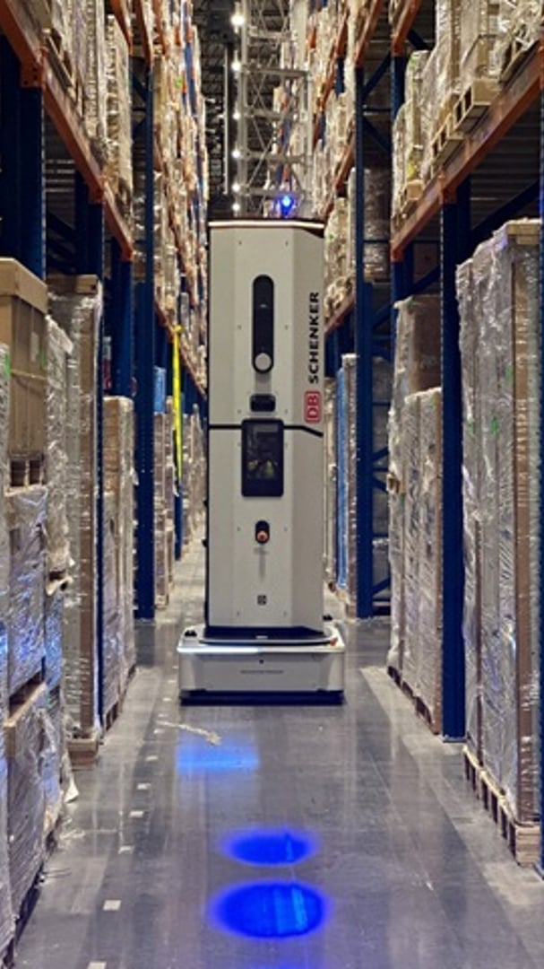
Inventory Management Optimization
AI-Driven Inventory Insights
AI technologies analyze historical data and current trends to provide actionable insights, enabling businesses to optimize stock levels, reduce excess inventory, and minimize carrying costs while ensuring product availability.
Automated Replenishment Processes
By implementing AI algorithms, companies can automate inventory replenishment, ensuring timely restocking based on real-time demand signals, which enhances operational efficiency and reduces the risk of stockouts.
Enhanced Forecasting Accuracy
AI improves forecasting accuracy by integrating various data sources, such as sales patterns and market trends, allowing businesses to make informed decisions about inventory management and align supply with actual demand.

Slide 11
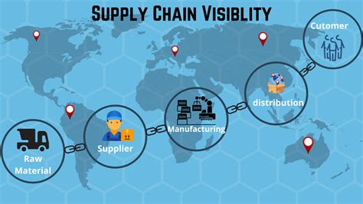


Real-Time Tracking and Visibility
Enhanced Supply Chain Transparency
Proactive Issue Resolution
Data-Driven Insights for Optimization
With real-time visibility, logistics managers can quickly identify and address potential disruptions, such as delays or route changes, allowing for proactive decision-making that minimizes impact on delivery schedules and customer satisfaction.
Real-time tracking provides stakeholders with immediate access to shipment status and location, fostering transparency and trust among partners, which is essential for effective supply chain collaboration.
The continuous flow of real-time data enables companies to analyze performance metrics and trends, leading to informed strategic adjustments that enhance overall supply chain efficiency and responsiveness to market demands.

Slide 12
Reducing Operational Costs with AI
01
02
03
Automated Process Optimization
Predictive Maintenance Strategies
Intelligent Resource Allocation
Implementing AI-driven automation in logistics processes reduces manual labor and operational errors, leading to significant cost savings and increased efficiency in supply chain management.
By utilizing AI algorithms for demand forecasting and route optimization, companies can allocate resources more effectively, reducing excess inventory and transportation costs while improving service delivery.
AI can analyze equipment performance data to predict maintenance needs, minimizing downtime and repair costs, which ultimately lowers operational expenses and enhances productivity.

Slide 13
Section 3
Challenges and Considerations

Slide 14



Data Privacy and Security Concerns
Data Protection Regulations
Risk of Data Breaches
Ethical Use of Data
Compliance with data protection regulations such as GDPR and CCPA is crucial for logistics companies utilizing AI, as failure to adhere can result in significant fines and damage to reputation, necessitating robust data governance frameworks.
The integration of AI in logistics increases the risk of data breaches, as sensitive customer and operational data are processed and stored, highlighting the need for advanced cybersecurity measures to protect against unauthorized access and data theft.
Ensuring the ethical use of data collected through AI systems is essential, as companies must balance operational efficiency with consumer privacy rights, fostering trust and transparency in their data handling practices.

Slide 15
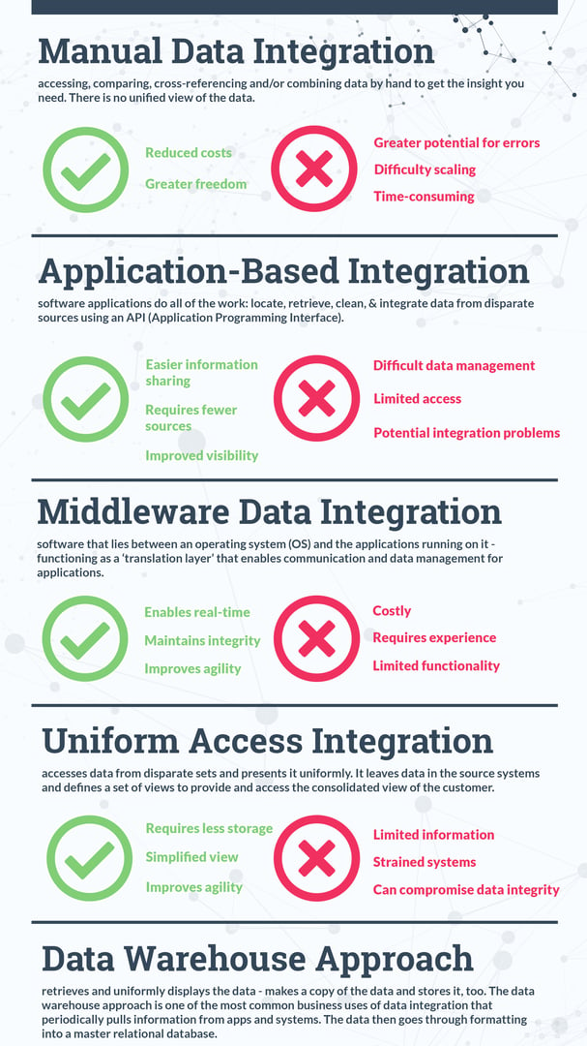
Integration with Existing Systems
Seamless Data Exchange
Integrating AI technologies with existing logistics systems enables seamless data exchange, allowing for real-time insights and improved decision-making across the supply chain, ultimately enhancing operational efficiency.
Legacy System Compatibility
AI solutions can be designed to work alongside legacy systems, ensuring that companies can leverage their current investments while gradually transitioning to more advanced technologies without disrupting ongoing operations.
Enhanced Collaboration Tools
The integration of AI fosters the development of collaborative tools that connect various stakeholders in the supply chain, improving communication, coordination, and responsiveness to market changes, which is vital for maintaining competitive advantage.

Slide 16
Skills Gap and Workforce Training
01
02
03
Identifying Skills Shortages
Importance of Continuous Training
Strategic Partnerships for Development
The logistics and supply chain sector faces a significant skills gap, particularly in areas such as data analytics, AI technology, and digital literacy, which are essential for leveraging AI advancements effectively in operations.
Workforce training is crucial to equip employees with the necessary skills to adapt to AI technologies, ensuring they can effectively utilize new tools and processes, thereby enhancing productivity and operational efficiency.
Collaborating with educational institutions and training organizations can help logistics companies develop tailored training programs that address specific skills gaps, fostering a more competent workforce ready to meet the challenges of AI transformation.

Slide 17


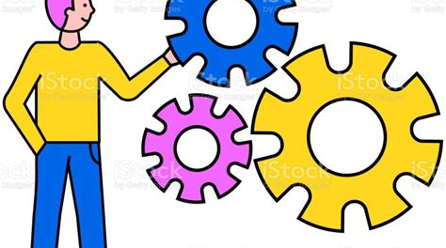
Regulatory and Compliance Issues
Navigating Legal Frameworks
Impact of Compliance on Innovation
Collaboration with Regulatory Bodies
Logistics companies must stay informed about evolving regulations governing AI technologies, including data protection laws and industry-specific compliance requirements, to mitigate legal risks and ensure operational integrity.
Striking a balance between regulatory compliance and innovation is crucial; overly stringent regulations may stifle technological advancements, while a lack of oversight can lead to ethical dilemmas and public distrust in AI applications.
Engaging with regulatory authorities and industry groups can help logistics companies shape policies that promote responsible AI use, ensuring that compliance measures support both business objectives and societal interests.

Slide 18
Section 4
Embrace AI for Logistics & Supply Chain

Slide 19
Embrace AI for Competitive Advantage
01
02
03
Unlocking Operational Efficiency
Data-Driven Decision Making
Gaining Market Leadership
By adopting AI technologies, businesses can streamline logistics processes, automate routine tasks, and optimize resource allocation, leading to significant cost savings and enhanced operational efficiency.
AI empowers companies to leverage vast amounts of data for predictive analytics, enabling informed decision-making that enhances supply chain responsiveness and adaptability to market changes.
Embracing AI not only improves current operations but also positions businesses as innovators in the logistics sector, allowing them to stay ahead of competitors and meet evolving customer expectations effectively.

Slide 20
Invest in Training and Development
Empowering Workforce Skills
Investing in training and development equips employees with the necessary skills to effectively utilize AI technologies, ensuring they can adapt to new tools and processes that enhance logistics operations.
Fostering Innovation and Adaptability
Continuous training encourages a culture of innovation, enabling teams to stay updated on the latest AI advancements and apply them creatively to solve complex supply chain challenges.
Maximizing ROI on AI Investments
By prioritizing workforce development, companies can maximize their return on investment in AI technologies, as a skilled workforce is essential for leveraging AI's full potential and driving operational success.

Slide 21


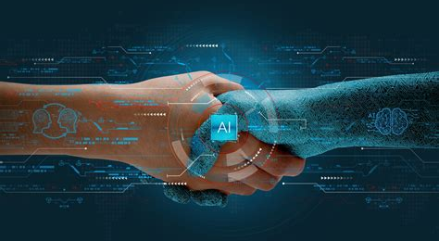
Collaborate with Technology Partners
Strategic Alliances for Innovation
Shared Resources and Knowledge
Risk Mitigation and Scalability
Collaborating with technology partners allows logistics companies to access cutting-edge AI solutions and expertise, fostering innovation that can lead to enhanced operational efficiencies and competitive advantages in the market.
Partnerships enable the sharing of resources, data, and best practices, which can accelerate the implementation of AI technologies and improve overall supply chain performance through collective intelligence and experience.
Working with established technology partners helps mitigate risks associated with AI adoption, providing companies with scalable solutions that can adapt to changing market demands and technological advancements, ensuring long-term sustainability.

Slide 22
Join Us!
Interested in learning more about how AI can enhance your Logistics & Supply Chain experience?
Contact us today to discover our innovative solutions tailored to meet your need
Contact: koncpt.ai@gmail.com

