Slide 1
How AI is Transforming Education & EdTech
Presenter: AI Education Initiative

Slide 2
Content
1. The Role of AI in Modern Education
2. AI Technologies Shaping EdTech
3. Future Trends in AI and Education
4. Embrace AI in Education & Edtech

Slide 3
Section 1
The Role of AI in Modern Education

Slide 4
Introduction to AI in Education
01
02
03
Definition of AI in Education
Significance of AI Integration
Impact on Learning Outcomes
Artificial Intelligence (AI) refers to the simulation of human intelligence processes by machines, particularly computer systems, which can enhance educational experiences through personalized learning and adaptive assessments.
The integration of AI in education is crucial as it enables tailored learning experiences, improves student engagement, and provides educators with data-driven insights to enhance teaching methodologies.
AI technologies have the potential to significantly improve learning outcomes by identifying individual student needs, facilitating real-time feedback, and fostering a more inclusive learning environment.

Slide 5
Benefits of AI for Students and Educators
Personalized Learning Experiences
AI enables the customization of educational content to meet individual student needs, allowing for differentiated instruction that caters to various learning styles and paces, ultimately enhancing student engagement and retention.
Enhanced Administrative Efficiency
Educators benefit from AI-driven tools that automate administrative tasks such as grading and scheduling, freeing up valuable time for teachers to focus on instruction and student interaction, thereby improving overall educational quality.
Data-Driven Insights for Improvement
AI systems analyze vast amounts of educational data to provide actionable insights, helping educators identify trends, assess student performance, and implement targeted interventions that support student success and institutional effectiveness.

Slide 6
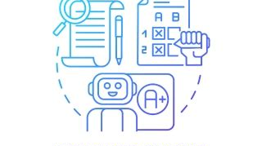
Case Studies of AI Implementation
AI in Personalized Learning
AI for Administrative Efficiency
AI in Assessment Tools
The use of Gradescope at Stanford University illustrates how AI can streamline the grading process for large classes, providing instant feedback to students and reducing grading time by 30%, thus improving the educational experience.
A case study from Carnegie Learning showcases how AI-driven platforms adapt math instruction to individual student needs, resulting in a 20% increase in student performance and engagement through tailored learning paths.
The University of Georgia implemented an AI system for managing student inquiries, which reduced response times by 50% and allowed staff to focus on more complex student needs, enhancing overall service quality.

Slide 7
Challenges and Considerations
01
02
03
Data Privacy Concerns
Equity and Access Issues
Resistance to Change
The implementation of AI in education raises significant data privacy issues, as sensitive student information must be collected and processed. Institutions must ensure compliance with regulations like FERPA and GDPR to protect student data from unauthorized access and misuse.
Educators and institutions may face resistance when integrating AI into their teaching practices due to a lack of understanding or fear of job displacement. Professional development and clear communication about the benefits of AI are essential to foster acceptance and effective implementation.
There is a risk that AI technologies may exacerbate existing inequalities in education, as not all students have equal access to the necessary technology and resources. Ensuring equitable access to AI tools is crucial for maximizing their benefits across diverse student populations.

Slide 8
Section 2
AI Technologies Shaping EdTech

Slide 9
Overview of AI Technologies in EdTech
Natural Language Processing (NLP)
NLP technologies enable machines to understand and interpret human language, facilitating applications such as chatbots for student support, automated essay scoring, and personalized feedback systems that enhance communication between educators and learners.
Machine Learning Algorithms
These algorithms analyze educational data to identify patterns and predict student performance, allowing for adaptive learning systems that adjust content delivery based on individual progress, thereby optimizing the learning experience for each student.
Intelligent Tutoring Systems (ITS)
ITS leverage AI to provide personalized instruction and feedback, simulating one-on-one tutoring experiences. These systems adapt to student learning styles and paces, helping to improve comprehension and retention of complex subjects.

Slide 10
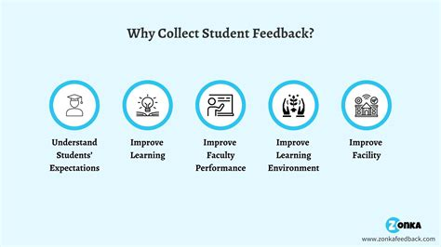
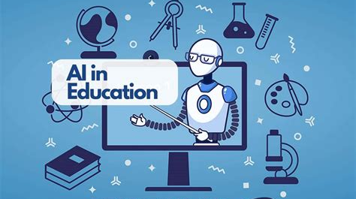
Personalized Learning through AI
Tailored Learning Pathways
Real-Time Feedback Mechanisms
Scalability of Personalized Education
AI technologies analyze individual student data to create customized learning experiences, allowing students to progress at their own pace and focus on areas where they need the most support, ultimately enhancing engagement and retention.
AI systems provide immediate feedback on student performance, enabling timely interventions and adjustments to learning strategies, which helps students understand their strengths and weaknesses more effectively.
AI facilitates the scalability of personalized learning by automating content delivery and assessment, making it feasible to implement individualized learning plans for large groups of students without compromising quality.

Slide 11
AI-Driven Assessment Tools
01
02
03
Automated Grading Systems
Adaptive Testing Technologies
Data Analytics for Performance Insights
AI-driven assessment tools utilize algorithms to automate the grading process, significantly reducing the time educators spend on evaluations while ensuring consistency and objectivity in scoring, which enhances the overall efficiency of educational assessments.
These tools adjust the difficulty of questions based on student responses, providing a more accurate measure of a learner's abilities and knowledge, thereby allowing for a personalized assessment experience that can better inform instructional strategies.
AI assessment tools analyze student performance data to identify trends and learning gaps, enabling educators to make informed decisions about curriculum adjustments and targeted interventions that support student success and improve learning outcomes.

Slide 12
Virtual Classrooms and AI Integration
Enhanced Learning Engagement
AI technologies in virtual classrooms facilitate interactive learning experiences through personalized content delivery, gamification, and real-time feedback, significantly increasing student engagement and motivation in remote learning environments.
Intelligent Tutoring and Support
AI-powered virtual assistants and chatbots provide on-demand support to students, answering queries and offering guidance, which helps to create a more responsive and supportive learning atmosphere, especially in asynchronous learning settings.
Data-Driven Insights for Educators
The integration of AI in virtual classrooms allows educators to access detailed analytics on student performance and engagement, enabling them to tailor their teaching strategies and interventions based on real-time data, ultimately enhancing educational outcomes.

Slide 13
Section 3
Future Trends in AI and Education

Slide 14
Emerging AI Technologies in Education
Adaptive Learning Systems
AI-Powered Learning Analytics
Virtual Reality (VR) and AI Integration
These systems utilize AI algorithms to analyze student performance in real-time, allowing for the customization of educational content and pacing to meet individual learning needs, thereby enhancing student engagement and success rates.
By leveraging big data and machine learning, educational institutions can gain insights into student behaviors and learning patterns, enabling educators to make informed decisions that improve curriculum design and instructional strategies.
The combination of VR and AI technologies creates immersive learning experiences that simulate real-world scenarios, fostering deeper understanding and retention of complex subjects while catering to diverse learning styles.

Slide 15
Predictions for AI in EdTech
Increased Personalization
Future AI systems will leverage advanced algorithms to provide even more personalized learning experiences, adapting in real-time to student needs and preferences, which will enhance engagement and improve learning outcomes.
Widespread Adoption of AI Tools
As AI technologies become more accessible and affordable, educational institutions are expected to increasingly adopt AI-driven tools for administration, assessment, and personalized learning, leading to a transformation in traditional educational practices.
Enhanced Data Analytics Capabilities
The evolution of AI will enable more sophisticated data analytics, allowing educators to gain deeper insights into student performance and learning behaviors, ultimately informing instructional strategies and improving educational effectiveness.

Slide 16
Preparing for an AI-Enhanced Learning Environment
01
02
03
Infrastructure Readiness
Professional Development for Educators
Stakeholder Engagement and Collaboration
Educational institutions must assess and upgrade their technological infrastructure, including hardware, software, and internet connectivity, to support the integration of AI tools and ensure seamless access for both educators and students.
Comprehensive training programs should be established to equip educators with the necessary skills and knowledge to effectively utilize AI technologies, fostering a culture of innovation and adaptability within the teaching workforce.
Engaging all stakeholders, including administrators, teachers, students, and parents, is crucial for successful AI implementation. Collaborative efforts can help address concerns, gather feedback, and create a shared vision for an AI-enhanced learning environment.

Slide 17
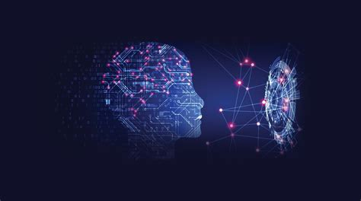
Ethical Considerations in AI Education
Data Privacy and Security
Bias and Fairness in Algorithms
Transparency and Accountability
The integration of AI in education necessitates stringent measures to protect student data, ensuring compliance with privacy regulations and safeguarding against unauthorized access, which is critical for maintaining trust in educational institutions.
AI systems can inadvertently perpetuate biases present in training data, leading to unfair treatment of certain student groups. It is essential to implement strategies for bias detection and mitigation to promote equity and inclusivity in educational outcomes.
Educators and institutions must prioritize transparency in AI decision-making processes, providing clear explanations of how AI tools operate and the rationale behind their recommendations, fostering accountability and informed consent among stakeholders.

Slide 18
Section 4
Embrace AI in Education & Edtech

Slide 19
Engaging Stakeholders in AI Adoption
Importance of Stakeholder Involvement
Engaging stakeholders, including educators, administrators, students, and parents, is essential for successful AI adoption in education, as their insights and concerns can shape effective implementation strategies and foster a collaborative environment.
Building Trust and Understanding
Establishing trust through transparent communication about the benefits and limitations of AI technologies is crucial. Providing stakeholders with clear information and opportunities for dialogue can alleviate fears and misconceptions surrounding AI in education.
Creating Collaborative Frameworks
Developing frameworks that encourage collaboration among stakeholders can enhance the integration of AI tools. This includes forming committees, conducting workshops, and facilitating feedback sessions to ensure that diverse perspectives are considered in the decision-making process.

Slide 20
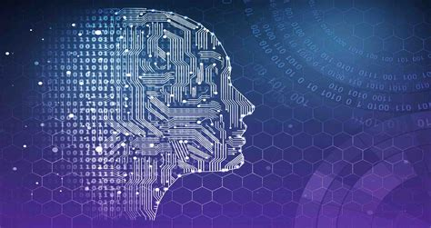
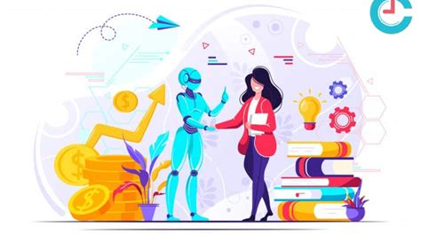
Encouraging Educators to Embrace AI Tools
Professional Development Opportunities
Showcasing Success Stories
Creating Supportive Communities
Providing targeted training and resources for educators is essential to help them understand and effectively utilize AI tools in their teaching practices, fostering confidence and competence in integrating technology into the classroom.
Highlighting case studies and examples of successful AI implementation in educational settings can inspire educators to adopt these tools, demonstrating tangible benefits such as improved student engagement and learning outcomes.
Establishing networks and communities of practice among educators can facilitate knowledge sharing and collaboration, allowing teachers to exchange experiences, strategies, and best practices for leveraging AI tools in their instruction.

Slide 21
Next Steps for Institutions and Policymakers
01
02
03
Develop Comprehensive AI Strategies
Invest in Training and Resources
Establish Ethical Guidelines and Standards
Policymakers must prioritize funding for professional development programs that equip educators with the skills necessary to utilize AI tools effectively, fostering a culture of innovation and adaptability within educational institutions.
Institutions should create detailed plans that outline the integration of AI technologies in education, focusing on aligning AI initiatives with educational goals, resource allocation, and stakeholder engagement to ensure effective implementation.
Institutions and policymakers should collaborate to develop ethical frameworks that govern the use of AI in education, addressing issues such as data privacy, algorithmic bias, and transparency to promote equitable and responsible AI practices.

Slide 22
Join Us!
Interested in learning more about how AI can enhance your Education & Edtech experience?
Contact us today to discover our innovative solutions tailored to meet your needs.
Contact: ai.education@initiative.org

