Slide 1
How AI is Transforming Technology & Innovation Businesses
Presenter: AI Transformation Team

Slide 2
Content
1. The Impact of AI on Business Operations
2. AI-Driven Innovation in Products and Services
3. Challenges and Considerations in AI Adoption
4. Embracing AI for Future Success

Slide 3
Section 1
The Impact of AI on Business Operations

Slide 4
Understanding AI and Its Capabilities
01
02
03
Defining Artificial Intelligence
Capabilities of AI Technologies
Transformative Impact on Industries
AI refers to the simulation of human intelligence in machines programmed to think and learn, enabling them to perform tasks that typically require human cognitive functions.
AI encompasses various technologies such as machine learning, natural language processing, and computer vision, which empower businesses to automate processes, analyze vast data sets, and enhance customer interactions.
By integrating AI, businesses can achieve unprecedented efficiency, innovate product offerings, and gain competitive advantages, fundamentally reshaping how industries operate and deliver value.

Slide 5
Streamlining Processes with AI
Automation of Routine Tasks
AI technologies can automate repetitive and time-consuming tasks, allowing employees to focus on higher-value activities, thus increasing overall productivity and job satisfaction.
Enhanced Workflow Efficiency
By analyzing data and identifying bottlenecks, AI can optimize workflows, streamline operations, and reduce delays, leading to faster project completion and improved service delivery.
Data-Driven Decision Making
AI systems can process and analyze large volumes of data in real-time, providing actionable insights that help businesses make informed decisions quickly, ultimately driving better outcomes and strategic growth.

Slide 6
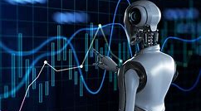
Enhancing Decision-Making through Data Analytics
Data-Driven Insights
Predictive Analytics for Strategy
Real-Time Decision Support
Leveraging AI-powered analytics enables businesses to extract meaningful insights from vast datasets, facilitating informed decision-making that aligns with market trends and consumer behavior.
AI tools provide real-time data analysis, empowering decision-makers with timely information that enhances responsiveness and agility in a rapidly changing business environment.
By utilizing predictive analytics, organizations can forecast future outcomes based on historical data, allowing them to proactively adjust strategies and mitigate risks before they arise.

Slide 7
Case Studies of AI Implementation in Businesses
01
02
03
Retail Revolution with AI
Healthcare Diagnostics Enhancement
Financial Services Automation
A leading retail chain implemented AI-driven inventory management systems, resulting in a 30% reduction in stockouts and a 20% increase in sales through optimized product placement and demand forecasting.
A major bank utilized AI for fraud detection, which enhanced their security measures and reduced fraudulent transactions by 40%, while also improving customer trust and satisfaction through quicker response times.
A healthcare provider adopted AI algorithms for diagnostic imaging, achieving a 15% improvement in accuracy and significantly reducing the time required for radiologists to analyze scans, leading to faster patient treatment.

Slide 8
Section 2
AI-Driven Innovation in Products and Services

Slide 9
Creating Smart Products with AI
Integration of AI Technologies
Smart products leverage AI technologies such as machine learning and IoT to enhance functionality, enabling devices to learn from user interactions and adapt to preferences for a more personalized experience.
Real-Time Data Processing
By utilizing AI, smart products can analyze data in real-time, allowing for immediate responses to user needs, improving efficiency, and providing insights that enhance user engagement and satisfaction.
Innovative Product Development
AI-driven insights facilitate the creation of innovative products that meet emerging market demands, enabling businesses to stay competitive by rapidly iterating on designs and features based on consumer feedback and behavior analysis.

Slide 10
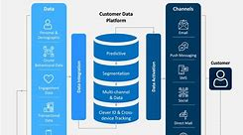
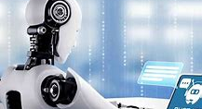
Personalization and Customer Experience Enhancement
AI-Driven Customer Insights
Dynamic Content Customization
Enhanced Customer Interactions
AI technologies analyze customer data to uncover preferences and behaviors, enabling businesses to tailor their offerings and communications, resulting in a more personalized and engaging customer experience.
By leveraging machine learning algorithms, companies can deliver personalized content and product recommendations in real-time, enhancing user satisfaction and increasing conversion rates through targeted marketing strategies.
AI-powered chatbots and virtual assistants provide instant support and personalized responses, improving customer service efficiency and fostering stronger relationships by addressing individual needs and inquiries promptly.

Slide 11
The Role of AI in Service Automation
01
02
03
Efficiency in Service Delivery
Improved Customer Engagement
Data-Driven Service Optimization
AI automates routine service tasks, such as scheduling and customer inquiries, significantly reducing response times and allowing businesses to allocate resources more effectively, enhancing overall operational efficiency.
By utilizing AI-driven tools like chatbots and virtual assistants, businesses can provide 24/7 support, ensuring that customer queries are addressed promptly, which leads to higher satisfaction and loyalty rates.
AI analyzes customer interactions and feedback to identify trends and areas for improvement, enabling businesses to refine their service offerings continuously and adapt to changing customer needs and preferences.

Slide 12
Examples of Innovative AI Solutions
AI in Healthcare Diagnostics
Innovative AI solutions are revolutionizing healthcare by enhancing diagnostic accuracy through machine learning algorithms that analyze medical images, leading to faster and more reliable patient care.
Smart Manufacturing Systems
AI-driven automation in manufacturing optimizes production processes by predicting equipment failures and streamlining supply chain management, resulting in reduced downtime and increased operational efficiency.
Personalized Marketing Strategies
Companies are leveraging AI to analyze consumer behavior and preferences, enabling the creation of highly targeted marketing campaigns that improve customer engagement and drive sales growth.

Slide 13
Section 3
Challenges and Considerations in AI Adoption

Slide 14
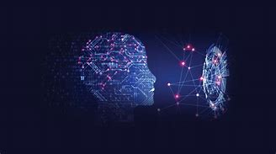
Ethical Implications of AI in Business
Bias and Fairness Concerns
Transparency and Accountability
Impact on Employment
AI systems can inadvertently perpetuate biases present in training data, leading to unfair treatment of certain groups. Businesses must implement rigorous testing and monitoring to ensure AI applications promote equity and do not reinforce societal inequalities.
The integration of AI in business processes raises concerns about job displacement and workforce changes. Organizations need to develop strategies for reskilling employees and creating new roles that leverage AI technologies, ensuring a balanced approach to innovation and workforce sustainability.
The complexity of AI algorithms can obscure decision-making processes, making it challenging to hold systems accountable. Companies should prioritize transparency in AI operations, providing clear explanations of how decisions are made to build trust with stakeholders.

Slide 15
Overcoming Resistance to Change
01
02
03
Engaging Stakeholders Early
Providing Comprehensive Training
Communicating Clear Benefits
Involve key stakeholders from the outset to foster a sense of ownership and commitment to AI initiatives, addressing concerns and gathering valuable insights that can shape the implementation process effectively.
Articulate the tangible benefits of AI adoption, such as improved efficiency and competitive advantage, to create a compelling narrative that motivates employees to embrace change rather than resist it.
Offer targeted training programs that equip employees with the necessary skills to work alongside AI technologies, alleviating fears of obsolescence and empowering them to leverage AI for enhanced productivity and innovation.

Slide 16
Ensuring Data Privacy and Security
Critical Importance of Data Privacy
As businesses increasingly adopt AI technologies, safeguarding sensitive data becomes paramount to maintain customer trust and comply with regulations, ensuring that personal information is protected from unauthorized access and breaches.
Implementing Robust Security Measures
Organizations must adopt comprehensive security frameworks, including encryption, access controls, and regular audits, to mitigate risks associated with data handling and AI system vulnerabilities, thereby enhancing overall data integrity.
Balancing Innovation with Compliance
While leveraging AI for innovation, businesses must navigate the complex landscape of data protection laws, ensuring that their AI applications not only drive growth but also adhere to legal standards, fostering a culture of responsible AI use.

Slide 17
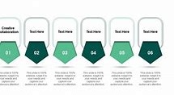
Balancing Human and AI Collaboration
Enhancing Human Creativity
Complementary Skill Sets
Continuous Learning and Adaptation
AI can handle repetitive tasks, allowing human employees to focus on creative problem-solving and innovative thinking, ultimately leading to more effective collaboration and enhanced business outcomes.
By leveraging the strengths of both humans and AI, businesses can create a synergistic environment where AI provides data-driven insights while humans apply emotional intelligence and contextual understanding to make informed decisions.
A balanced approach encourages ongoing training and development for employees to work effectively with AI technologies, fostering a culture of adaptability that is essential for navigating the rapidly evolving business landscape.

Slide 18
Section 4
Embracing AI for Future Success

Slide 19
The Importance of Staying Ahead in Technology
01
02
03
Competitive Advantage through AI
Future-Proofing Business Strategies
Driving Innovation and Efficiency
Embracing AI technologies allows businesses to innovate faster, streamline operations, and enhance customer experiences, positioning them ahead of competitors who may lag in adoption.
Staying ahead in technology ensures that organizations can adapt to market changes and consumer demands, reducing the risk of obsolescence and enabling sustainable growth in a rapidly evolving landscape.
By integrating AI into their operations, businesses can unlock new opportunities for innovation, improve efficiency, and make data-driven decisions that lead to better outcomes and increased profitability.

Slide 20
Steps to Integrate AI into Your Business Strategy
Assess Current Capabilities
Begin by evaluating your existing technology infrastructure and workforce skills to identify gaps and opportunities for AI integration, ensuring alignment with your business goals and objectives.
Define Clear Objectives
Establish specific, measurable goals for AI implementation, such as improving operational efficiency, enhancing customer experience, or driving innovation, to guide your strategy and measure success effectively.
Develop a Roadmap for Implementation
Create a detailed plan outlining the steps for AI integration, including timelines, resource allocation, and stakeholder engagement, to ensure a structured approach that facilitates smooth adoption and minimizes disruption.

Slide 21
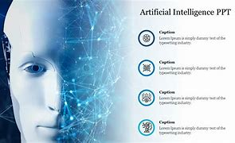
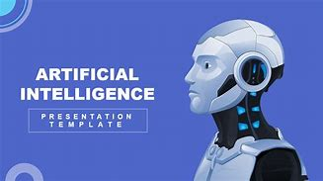
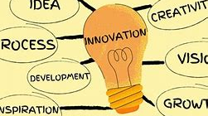
Join the AI Revolution Today!
Unlock Competitive Advantages
Future-Proof Your Business
Drive Innovation and Growth
By integrating AI into your strategy, you can adapt to changing consumer demands and market trends, ensuring long-term sustainability and resilience against disruption.
AI not only improves efficiency but also fosters a culture of innovation, enabling businesses to explore new opportunities and drive growth through data-driven insights and automation.
Embracing AI technologies empowers businesses to streamline operations, enhance customer experiences, and innovate products, positioning them ahead of competitors in a rapidly evolving market.

Slide 22
Join Us!
Interested in learning more about how AI can enhance your Technology & Innovation experience?
Contact us today to discover our innovative solutions tailored to meet your needs.
Contact: Koncpt.ai@gmail.com

