Slide 1
How AI is Transforming the Food & Beverage Business
Presenter: Koncpt.AI

Slide 2
Content
1. The Impact of AI on Food Production
2. AI in Consumer Engagement
3. AI and Sustainability in the Food Industry
4. Call to Action: Embracing AI in Your Business

Slide 3
Section 1
The Impact of AI on Food Production

Slide 4
Enhancing Efficiency in Food Manufacturing
01
02
03
Streamlined Production Processes
Data-Driven Decision Making
Predictive Maintenance
Leveraging AI analytics allows manufacturers to analyze vast amounts of data in real-time, enabling informed decisions that enhance operational efficiency and resource allocation.
Implementing AI for predictive maintenance helps identify potential equipment failures before they occur, minimizing downtime and ensuring continuous production flow in food manufacturing facilities.
AI technologies optimize production workflows by automating repetitive tasks, reducing human error, and increasing overall throughput, leading to significant time and cost savings.

Slide 5
Quality Control through AI Technologies
Automated Quality Inspections
Data Analysis for Quality Trends
Enhanced Traceability and Compliance
AI technologies utilize computer vision to conduct real-time inspections of products, ensuring that only items meeting quality standards proceed through the production line, thereby reducing waste and enhancing product consistency.
By analyzing historical quality data, AI can identify patterns and trends that may indicate potential quality issues, allowing companies to proactively address problems before they escalate, thus maintaining high standards.
AI systems improve traceability throughout the supply chain, enabling companies to quickly identify and rectify sources of contamination or quality failures, ensuring compliance with industry regulations and boosting consumer trust.

Slide 6
Predictive Analytics for Supply Chain Management
Demand Forecasting Accuracy
Predictive analytics leverages historical data and market trends to enhance demand forecasting, allowing food and beverage companies to optimize inventory levels and reduce waste, ultimately improving profitability.
Supply Chain Risk Management
By analyzing potential disruptions and variability in supply chain processes, predictive analytics enables businesses to proactively manage risks, ensuring a more resilient supply chain that can adapt to unforeseen challenges.
Enhanced Supplier Collaboration
Predictive analytics fosters better communication and collaboration with suppliers by providing insights into demand patterns and inventory needs, leading to more strategic partnerships and improved supply chain efficiency.

Slide 7
Case Studies of Successful AI Implementation
01
02
03
Coca-Cola's AI-Driven Marketing
Nestlé's Supply Chain Optimization
PepsiCo's Quality Assurance Innovations
Coca-Cola utilizes AI algorithms to analyze consumer data and preferences, enabling personalized marketing campaigns that significantly increase customer engagement and sales conversion rates.
Nestlé implemented AI for predictive analytics in its supply chain, resulting in improved demand forecasting and inventory management, which reduced waste and enhanced operational efficiency across its global operations.
PepsiCo adopted AI-powered computer vision systems for quality control, allowing for real-time monitoring of product quality, which has led to a notable decrease in defects and an increase in overall product consistency.

Slide 8
Section 2
AI in Consumer Engagement

Slide 9
Personalization of Customer Experience
Tailored Recommendations
Dynamic Pricing Strategies
Enhanced Customer Interactions
AI algorithms analyze customer preferences and behaviors to provide personalized menu suggestions, enhancing the dining experience and increasing customer satisfaction and loyalty.
Utilizing AI, businesses can implement dynamic pricing models that adjust based on customer data, demand fluctuations, and purchasing patterns, maximizing revenue while offering competitive pricing.
AI-driven chatbots and virtual assistants facilitate personalized communication with customers, addressing inquiries and preferences in real-time, which fosters a more engaging and responsive customer service experience.

Slide 10
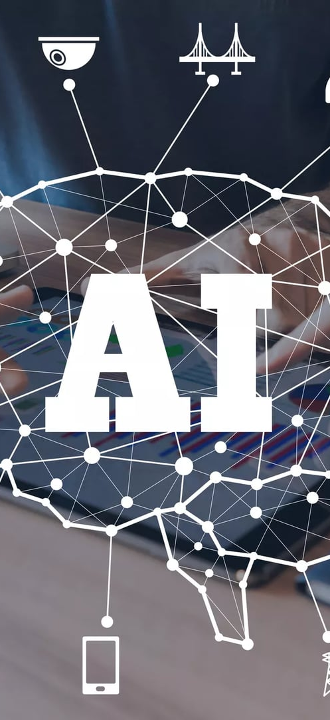
AI-Driven Marketing Strategies
Targeted Advertising Campaigns
AI enables food and beverage companies to analyze consumer data and preferences, allowing for the creation of highly targeted advertising campaigns that resonate with specific demographics, increasing engagement and conversion rates.
Real-Time Consumer Insights
By leveraging AI analytics, businesses can gain real-time insights into consumer behavior and market trends, enabling them to adjust marketing strategies swiftly and effectively to meet changing consumer demands.
Enhanced Customer Segmentation
AI tools facilitate advanced customer segmentation by identifying unique consumer profiles and behaviors, allowing companies to tailor their marketing messages and promotions to different segments for improved effectiveness.

Slide 11
Chatbots and Customer Service Automation
01
02
03
24/7 Customer Support Availability
Efficient Order Management
Personalized Customer Interactions
Automation through chatbots streamlines the order process by allowing customers to place, modify, or track their orders seamlessly, reducing wait times and improving overall operational efficiency.
Chatbots provide round-the-clock assistance, ensuring that customer inquiries are addressed promptly, which enhances customer satisfaction and loyalty in the competitive food and beverage industry.
AI-driven chatbots utilize customer data to deliver tailored responses and recommendations, creating a more engaging experience that fosters stronger relationships between brands and their customers.

Slide 12
Analyzing Consumer Behavior with AI
Understanding Consumer Preferences
Behavioral Prediction Models
Enhanced Customer Feedback Analysis
AI analyzes vast datasets from consumer interactions, enabling businesses to identify trends and preferences, which helps in tailoring products and marketing strategies to meet specific consumer needs.
By employing machine learning algorithms, companies can predict future consumer behaviors based on past purchasing patterns, allowing for proactive adjustments in inventory and marketing efforts to align with anticipated demand.
AI tools facilitate the analysis of customer feedback from various channels, providing insights into consumer sentiment and satisfaction, which can inform product development and improve overall customer experience.

Slide 13
Section 3
AI and Sustainability in the Food Industry

Slide 14
Reducing Food Waste with AI Solutions
Smart Inventory Management
AI algorithms analyze sales patterns and expiration dates to optimize inventory levels, ensuring that food products are used before they spoil, thereby significantly reducing waste in the food and beverage industry.
Predictive Analytics for Demand Forecasting
By leveraging historical data and market trends, AI can accurately predict consumer demand, allowing businesses to adjust production schedules and minimize overproduction, which is a major contributor to food waste.
Real-Time Monitoring and Alerts
AI-powered systems can monitor food storage conditions in real-time, sending alerts for temperature fluctuations or nearing expiration dates, enabling timely interventions that prevent spoilage and waste.

Slide 15
Sustainable Sourcing through Data Analysis
Data-Driven Supplier Selection
Traceability and Transparency
Optimizing Resource Use
Utilizing data analysis allows companies to evaluate suppliers based on sustainability metrics, such as environmental impact and ethical practices, ensuring that sourcing decisions align with corporate sustainability goals.
Advanced data analytics enhance traceability in the supply chain, enabling businesses to track the origin of ingredients and materials, which fosters transparency and builds consumer trust in sustainable sourcing practices.
By analyzing data on resource consumption and sourcing patterns, companies can identify opportunities to reduce waste and improve efficiency, leading to more sustainable practices in the procurement of raw materials.

Slide 16
Energy Efficiency in Food Production
01
02
03
AI-Driven Energy Management
Predictive Analytics for Equipment Efficiency
Smart Resource Allocation
By utilizing AI algorithms, food producers can optimize resource allocation, such as water and energy, based on production schedules and demand forecasts, enhancing overall sustainability and operational efficiency.
Implementing AI systems allows food production facilities to monitor and optimize energy consumption in real-time, leading to significant reductions in energy costs and carbon footprints.
AI can analyze equipment performance data to predict maintenance needs, ensuring that machinery operates at peak efficiency and reducing energy waste associated with underperforming equipment.

Slide 17
Innovations in Eco-Friendly Packaging
Biodegradable Materials Development
Advances in AI are driving the creation of biodegradable packaging materials that decompose naturally, reducing environmental impact and appealing to eco-conscious consumers in the food and beverage sector.
Smart Packaging Solutions
AI technologies enable the design of smart packaging that can monitor freshness and provide real-time data to consumers, enhancing product safety while minimizing waste through better inventory management.
Optimized Packaging Design
AI algorithms analyze consumer preferences and environmental data to optimize packaging designs, ensuring minimal material use while maintaining product integrity, thus promoting sustainability in the food and beverage industry.

Slide 18
Section 4
Embracing AI in Your Business

Slide 19
Steps to Integrate AI into Your Operations
Assess Current Operations
Develop a Strategic Plan
Invest in Training and Support
Conduct a thorough evaluation of existing processes to identify areas where AI can enhance efficiency, reduce costs, and improve decision-making, ensuring alignment with business goals.
Create a comprehensive roadmap that outlines the integration of AI technologies, including timelines, resource allocation, and key performance indicators to measure success and impact on operations.
Provide ongoing training for staff to ensure they are equipped to work with AI tools, fostering a culture of innovation and adaptability that maximizes the benefits of AI integration in food and beverage operations.

Slide 20
Resources for Learning and Development
Online Courses and Certifications
Explore platforms like Coursera and edX that offer specialized courses on AI applications in the food and beverage industry, providing valuable knowledge and skills for professionals looking to enhance their expertise.
Industry Reports and Whitepapers
Access comprehensive reports from organizations such as McKinsey and Deloitte that analyze the impact of AI on the food sector, offering insights into trends, challenges, and best practices for leveraging AI effectively.
Networking and Professional Associations
Join industry groups like the Food and Beverage Innovation Network to connect with peers, share experiences, and stay updated on the latest AI developments and resources tailored for the food and beverage business.

Slide 21
Join the AI Revolution in Food & Beverage
01
02
03
Unlock Competitive Advantage
Enhance Customer Experience
Drive Sustainable Practices
Embracing AI technologies can significantly enhance operational efficiency, allowing businesses to streamline processes, reduce costs, and ultimately gain a competitive edge in the fast-evolving food and beverage market.
By leveraging AI for personalized marketing and customer engagement, businesses can create tailored experiences that resonate with consumers, fostering loyalty and driving repeat business in a crowded marketplace.
AI can play a crucial role in promoting sustainability within the food and beverage industry by optimizing resource use, reducing waste, and improving supply chain transparency, aligning with consumer demand for eco-friendly practices.

Slide 22
Join Us!
Interested in learning more about how AI can enhance yourFood & Beverage Business experience?
Contact us today to discover our innovative solutions tailored to meet your needs.
Contact: Koncpt.ai@gmail.com

